Slide 1
Weapons of Mass Disruption
Securing Radioactive Materials

Slide 2
Securing Radioactive Materials
Who are we?
What is MIAN?
Existing Regulations
    United States Nuclear Regulatory Commission
    Agreement States
    International Atomic Energy Agency
Weaknesses in Current Security
Results of Phase I Grant
Objectives of Phase II Grant
Additional Resources
Notes:
This presentation provides a background for the current project as well as an overview of the scope and objectives for Phase II. The project was begun in 2009. The FBI and Interpol approached the Alfred P. Sloan Foundation with the concern that radioactive materials could be obtained from domestic USA sources and utilized as terrorist weapons. The goal of this project is to reduce the threat from radioactive materials used in the medical, industrial and academic communities as well as materials obtained from foreign sources.

Slide 3
Who are we?
In 2009, the Alfred P. Sloan Foundation contacted ASME . Sloan had been asked to investigate the risk of terrorist using an RDD* or “dirty bomb”
Sloan (Nov 2009) provided a grant to ASME-ITI to investigate the risk and determine how to reduce risk (Phase I)
The Phase I report delivered Feb 2011
Phase II grant awarded July 2011
Phase II Deliverables December 31, 2012
*Radioactive Dispersion Device
Notes:
The principal investigator for this project is Dr. J. William Jones. Technical expertise is provided by Dr. Robert Nickell and John Haygood. Additional information can be found on the MIAM website, www.SecureRam.com.

Slide 4
What is MIAN?
MIAN is our abbreviation for Medical, Industrial and Academic Nuclear materials that could be exploited by terrorists
According to reliable sources there are over 25,000 sites in the United States that contain enough radioactive materials to cause serious consequences if obtained and deployed by terrorists
Notes:
Medical facilities such as hospitals and diagnostic centers use radioactive materials for numerous beneficial purposes. Industrial applications include radioactive sources for performing radiography of welds, oil well logging devices, smoke detectors, and many other uses. Universities and colleges utilize these materials for teaching and research purposes.

Slide 5
What is MIAN? (cont’d)
There are literally thousands of additional MIAN sites worldwide. It is estimated that more than 30,000 such sites exist in China alone
Rogue nations have stores of radioactive materials
Thousands of sources have been stolen, lost, or are unaccounted for worldwide
Former Soviet Union countries are notorious for poor accountability
Notes:
Given the availability of radioactive materials, it is only a matter of time before they fall into the hands of terrorists.

Slide 6
Existing Regulations
Regulatory authorities include:
  United States Nuclear Regulatory Commission
  Agreement States (AS)
  International Atomic Energy Agency (IAEA)
Notes:
Each of these regulatory authorities will be discussed in the following slides.

Slide 7
U.S. Nuclear Regulatory Commission
Regulates uses of Radioactive materials
2002: DOE/NRC interagency working group formed on RDD
National Source Tracking System(NSTS) 2003
2005: Energy Policy Act
  1. Mandatory source tracking system
  2. Increased Controls of Cat. 1 and 2 materials
  3. Annual Report to Congress
Notes:
RDD= Radioactive Dispersal Devices
DOE= Department of Energy
Category 1 and 2 materials are defined by both isotope and quantity. IAEA also defines “Dangerous” materials in IAEA-TECHDOC-1334.

Slide 8
U.S. Nuclear Regulatory Commission (cont’d)
2005: NRC orders implementation of Increased Controls (IC) by licensees
  Better security with timely armed response
  More stringent access requirements
  Background checks for employees
Notes:
RDD = Radioactive Dispersal Devices
DOE = Department of Energy
Category 1 and 2 materials are defined by both isotope and quantity. IAEA also defines “Dangerous” materials in IAEA-TECHDOC-1334.

Slide 9
Agreement States
38 states provide own regulation
Rest are regulated by NRC directly
In May we attended the CRCPD* meeting in Orlando, FL. We demonstrated the Security Assessment Tools. All 38 states will receive the free CD containing the tools and documentation
*Conference of Radiation Control Program Directors
Notes:
Agreement states provide their own security under guidelines and training provided by the NRC.

Slide 10
International Atomic Energy Agency
Defines dangerous quantities of radioactive materials
Provides general guidelines for security
No regulatory authority in United States
Note: IAEA “dangerous” or D quantities are 1/10 the NRC “IC” value

Slide 11
Weaknesses in Current Security
Security was initially designed for safety of employees and accidental exposure
System security did not consider armed and/or suicidal terrorists
Dangerous (“D”) values are understated -Large consequences can result from small amounts of material
Theft from multiple sources can result in “stockpiling”

Slide 12
Weaknesses in Current Security
Self-protection from sources (i.e., high radiation exposure) overestimated
“Homegrown” terrorists emerging as high threat potential
Public fear of all things radioactive not properly anticipated
Deployment methods other than dirty bombs can be used
Notes:
“Homegrown” terrorists emerging as high threat potential. (list of them?)

Slide 13
Threats Including other than RDD
Appendix D of the Phase I report contains numerous Scenarios in which MIAN materials can be obtained and deployed-Including:
1. Field Sources - Radiographic, well logging, sources, gauges, etc.
2. Nuclear Pharmacies - Provide medical radioactive materials for legitimate buyers
3. Medical Facilities - Used for treatment or diagnosis
4. Irradiation Facility - Medical and food and packaging services
5. Universities - Research materials, test reactors

Slide 14
Threats Including other than RDD
6. Research Facility - Research materials
7. Stored Equipment
8. Bankrupt/Abandoned - sites that have no viable owner or caretaker
9. Industrial Facilities - Large gauging devices - refineries, chemical plants, etc.
10. Foreign Countries/Rogue nations

Slide 15
RECENT EVENTS OF CONCERN
No actual terrorist-induced RDD event has yet taken place anywhere in the world
Evidence of terrorist acquisition and attempted deployment of RDD material has been documented; interdiction and incomplete deployment have been successful
Non-terrorist theft and widespread orphan or “disused” sources have led to numerous costly dispersal events

Slide 16
RECENT EVENTS OF CONCERN (cont’d)
“Additional Actions Needed to Improve Security of Radiological Sources at U.S. Medical Facilities”
GAO-12-925 Sept. 2012
GAO recommends, among other things, that NRC strengthen its security requirements
Examples of poor security:
  - Irradiator containing almost 2,000 curies of cesium-137 was stored on a wheeled pallet accessible to a loading dock
  - Combination to a locked door containing 1,500 curies of cesium-137 was clearly written on the door frame
  - The number of people with unescorted access to the facility's radiological sources was estimated to be at least 500
  - NRC and Agreement State inspectors said the training NRC requires is insufficient

Slide 17
STATUS OF SECURITY EFFORTS
DOE Off Site Source Recovery Program is making useful, incremental progress on orphan sources
NRC Increased Controls (IC) program and its National Source Tracking System (NSTS) are in place, but have received criticism from GAO
NRC efforts to tighten source security in 2011 were not successful
DOE/NNSA security upgrade program for hospitals and medical facilities (321 out of 1,503 sites) is extremely valuable but very limited (see GAO report dated September 2012)

Slide 18
STATUS OF SECURITY EFFORTS
NRC has endorsed the IAEA Code of Conduct on the Safety and Security of Radioactive Sources and, by implication, the IAEA’s security guidance for radioactive sources
The resistance of MIAN users to further increased security controls implies that persuasion, simplicity, and self-motivated (voluntary) measures deserve greater attention
The Sloan Foundation program has been aimed at such a persuasive, simple, and self-evaluation tool for improving source security
The Sloan Foundation program tool is well connected to the 2009 IAEA Nuclear Security Series No. 11, the Implementing Guide for the Security of Radioactive Sources

Slide 19
Materials deemed most dangerous
Appendix A of the Phase I report contains a detailed analysis of the 14 isotopes considered for IC. An additional 10 are also briefly discussed. A summary table is provided.
Appendix A also contains a table that provides information regarding how these materials can be obtained and an estimate of the probability of success of obtaining
An abbreviated version of these tables follows on the next two slides

Slide 20
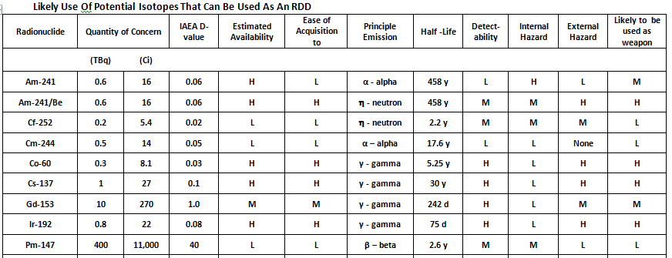
Most dangerous Isotopes

Slide 21
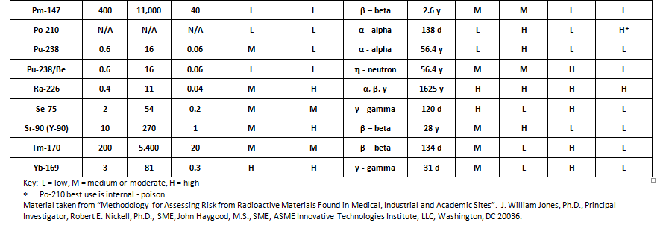
Most dangerous Isotopes (cont’d)

Slide 22
MIAN risk Differs from RAMCAP
Estimating terrorist risk to stationary targets (RAMCAP) is significantly different than MIAN risk
The differences are illustrated on the following slides

Slide 23
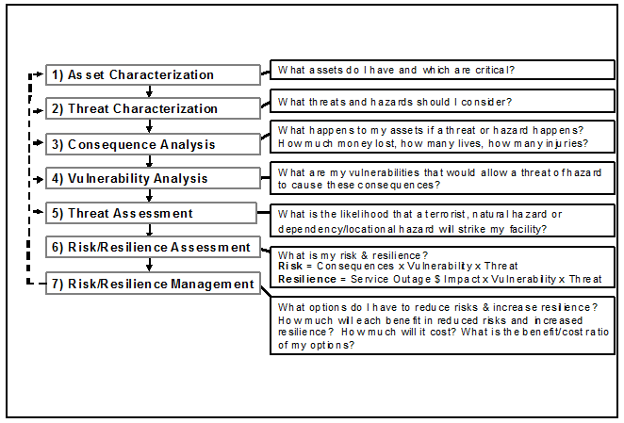
RAMCAP 7 step Process

Slide 24
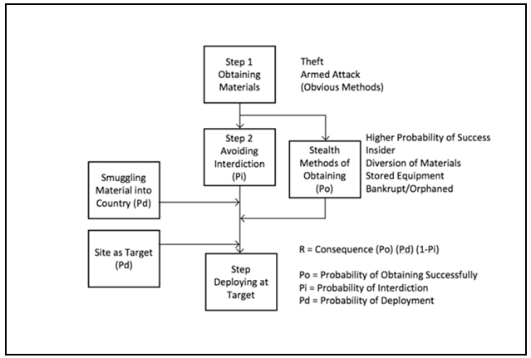
Mian risk Process

Slide 25
differences
RAMCAP seeks to determine terrorist risk for a specific target site
The site is the target and the “assets” at the site are used to cause consequences at and “near” the site
MIAN is comprised of three distinct acts:
  Obtain materials for nefarious purposes
  Transport materials to site of attack
  Deploy materials at site successfully

Slide 26
Overall Conclusions of Sloan Study
Since the site owners/operators cannot reduce the likelihood of success or consequences for steps 2 and 3, their best strategy is to prevent acquisition of materials.
Increasing security and awareness can be achieved by voluntary means.
Reporting loss immediately is key to reducing risk for steps 2 and 3.

Slide 27
Results of Phase I Grant
Risk methodology developed for MIAN materials
Comparison of Terrorist Risk vs. Natural Hazards
Compilation of MIAN materials
Development of Current Security Status Screening & Assessment Tool
Investigation of Possible Terrorist Scenarios
Examples of Risk Assessment Methodology
Site Visits & Pilot Assessments
Peer Review

Slide 28
Objectives of Phase II Grant
1. Finalize Security Enhancement Methodology
2. Finalize RAMCAP Risk Assessment Methodology
3. Develop Security Scoring Metrics
4. Consequence Estimation
5. Law Enforcement Review & Comment

Slide 29
Objectives of Phase II Grant (cont’d)
6. Regulator Review & Comment
7. Web Site Containing Useful Information
8. Distribute & Publicize Security Assessment Tools to all Interested Sites
9. Public Information & Dissemination

Slide 30
1. Finalized Security Enhancement Methodology
The initial security screening tool was revised and updated to incorporate comments and input from licensees, law enforcement and security consultants
After peer review and testing, this methodology will be distributed FREE to over 5,000 users on CD and can be downloaded by anyone who wishes to use it.

Slide 31
2. Finalize RAMCAP risk Assessment Methodology
The RAMCAP risk methodology has been updated. Additional work is needed to better define consequences and metrics for site assessment scoring.
Law enforcement input is needed to quantify values for probability of success and interdiction.

Slide 32
3. Developed Security Scoring Metrics
Scoring metrics were developed that provide a metrics for comparing a site against a “standard” score
Scoring depends upon the isotope and amount stored. Not limited to NRC levels for dangerous quantities

Slide 33
4. Consequence Estimation
Work is needed to provide better estimates for consequences of terrorist events
Consequence ranges are necessary to estimate overall risk
Estimates should include primary (target) and secondary (cascading) damages, casualties, and economic impact
Psychological effects not currently included
Notes:
Note: Psychological effects can include cascading nation-wide effects caused by an event at a single city such as loss of ridership to mass transit, reduced airline travel, loss of commerce to restaurants, sporting events, concerts, workplace absenteeism, or similar economic losses due to fear of another, similar event occurring. Consequences also do not include medical costs to treat psychological trauma.

Slide 34
5. Law Enforcement Review and Comment
In progress

Slide 35
6. Regulator Review and Comment
We are providing the materials developed in Phase II to regulators for review and comment
Agencies include:
  NRC
  Federal agencies: FBI, DHS
  Agreement States
  Local law enforcement agencies

Slide 36
7. Web Site Containing Useful Information
A web site has been developed that provides useful information such as:
  Background and introduction materials
  Screening and assessment tools
  Reports and source materials
  Media contacts
  Contact information for agencies and regulators
  Go to: www.SecureRAM.com

Slide 37
8. Distribute & Publicize Tools
Assessment tools are provided FREE to all MIAN sites
We will continue to work to increase awareness of the Security Assessment tools and encourage voluntary participation
Notes:
8. Distribute & Publicize Security Assessment Tools to All Interested Sites

Slide 38
9. Public Information & Dissemination
Goals
Increase public awareness of the possibility of the risk of terrorist events using radioactive materials
Reduce risk by increasing understanding and lowering the fear of an event
Discourage news media from overreacting should an event occur

Slide 39
Additional Resources
www.SecureRAM.com
Book: “The Terrorist Effect-Weapons of Mass Disruption-The Danger of Nuclear Terrorism” (Jones & Haygood); Available on Amazon, Barnes & Noble, etc. ISBN 978-1-4620-3932-6
Speakers Bureau to interface with media: under development
Notes:
If you would like to know more about how to become a spokesman for media contact, please contact one of the investigators (see next slide).

Slide 40
Contact Information
J. William (Bill) Jones - 714.369.2703
bill@jwjce.com www.jwjce.com
John Haygood - 512.551.2153
John.haygood@att.net
R. E. (Bob) Nickell - 619.255.9930
rnickell@cox.net
Isaac Maya - 213.949.6292
imaya@usc.edu
Notes:
Feel free to contact the investigators for additional information or to discuss how you can participate in securing radioactive materials.

